Slide 1
This is an overview of extensive work by many people

Slide 2
Attention, memory & symmetry
Nick Fisher
@NickFisherAU
19 June 2018

Slide 3

Name the movie…

Slide 4
Language isn’t necessarily sequential!

Slide 5
Example
The trophy could not fit in the suitcase because it was too
Does “it” refers to the trophy or the suitcase?
?
?

Slide 6
Notwithstanding, deep sequential models have been very successful
Language modelling – given a sequence of n tokens, predict the (n+1)th token
The cat sat on the _____

Slide 7
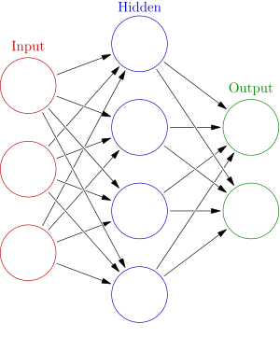
Vanilla recurrent neural network applied at each timestep in the sequence
The
cat
sat
on
Backpropagation through time
Repeated activations cause gradients to vanish or explode over long time lags
nothing can be learned
numerically unstable

Slide 8
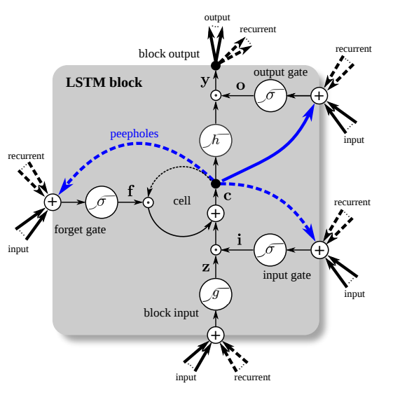
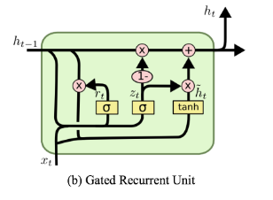
Solution?
Ensure constant error flow by gating
LSTM
https://arxiv.org/pdf/1503.04069v1.pdf
GRU
https://isaacchanghau.github.io/post/lstm-gru-formula/

Slide 9

SOTA performance for sequential prediction
Explicit state carried between time-steps
Information flow in/out regulating via gating
But!
Explicit dependency on (t-1) means cannot parallelize
Long-range dependencies still difficult despite gating
Overweight importance attached to recent time steps vs. further into the past

Slide 10
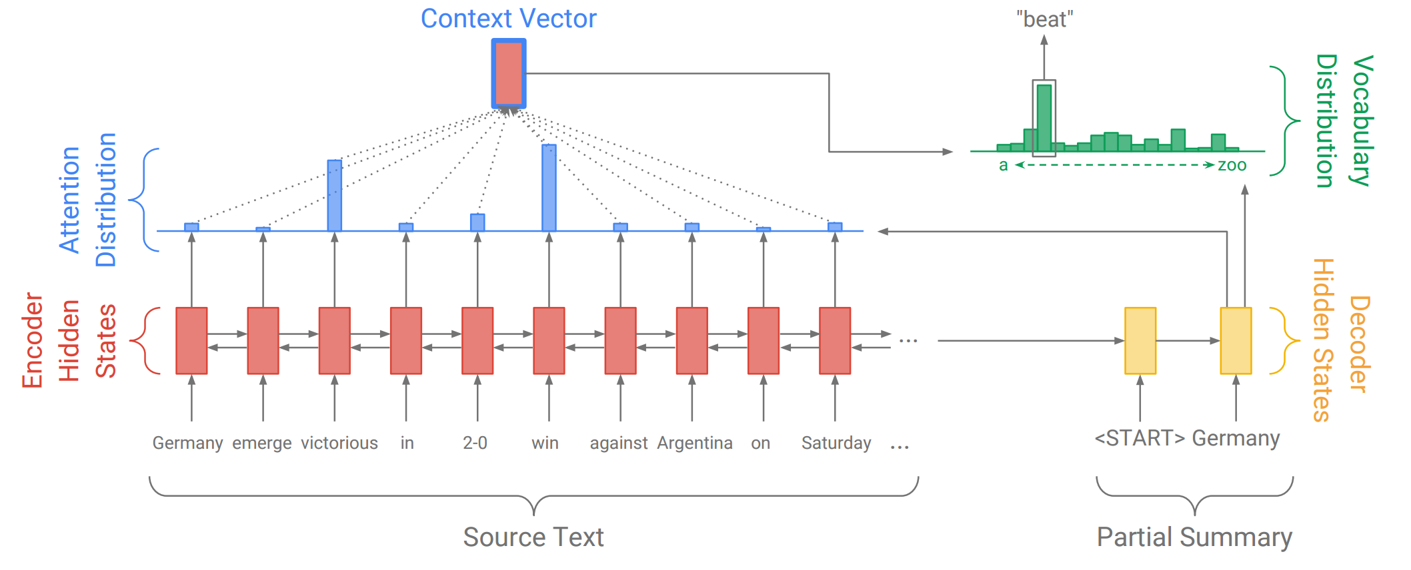
Attention!
Explicitly learn which elements are most important for a given task
E.g. Abstractive summarization
Output a word sequence that summarizes the input sequence
LSTM encoder-decoder model
encoder produces a state vector, decoder will (auto-regressively) produce the output sequence
Attention mechanism concurrently learn a context vector over encoder states
When decoding at step t, decoder has access to a weighted sum of all encoder states at step_{t-1} to step₀.
http://www.abigailsee.com/2017/04/16/taming-rnns-for-better-summarization.html

Slide 11
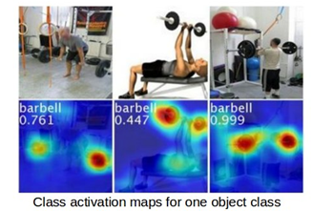
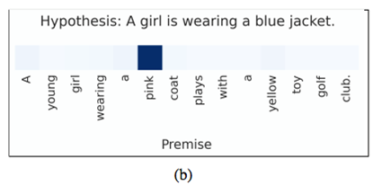
Entailment Attention
In deciding if the hypothesis is true, what words were most important?
Visual Attention
In classifying this image, where did I look?
http://cnnlocalization.csail.mit.edu/

Slide 12
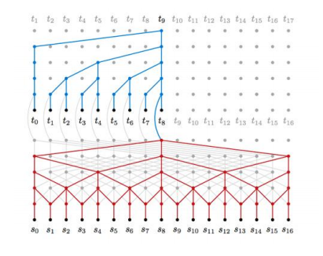
Attention+LSTM shortens pathways for longer range dependencies
Convolutional neural networks achieve similar effect via pooling/dilations
Maximum path length O(log_{k}(n)) vs O(n) for RNN
Parallelizable & lower parametrization = faster training
https://nlp.stanford.edu/seminar/details/lkaiser.pdf

Slide 13
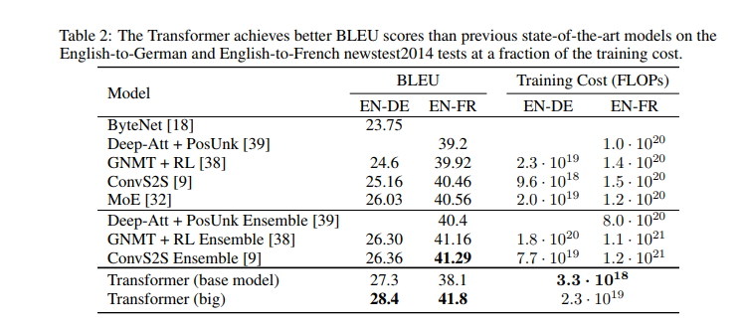
Self-attention
Constant path length between positions
The output at “time-step” t is a weighted average of inputs at every other “time-step”, past and future
You knew there was a reason for the “Arrival” logogram at the start of this presentation…
How much linguistic processing is sequential vs parallel?
Either way, it works!
Google’s Transformer – stacked multi-head self-attention – SOTA translation results in a fraction of training time

Slide 14
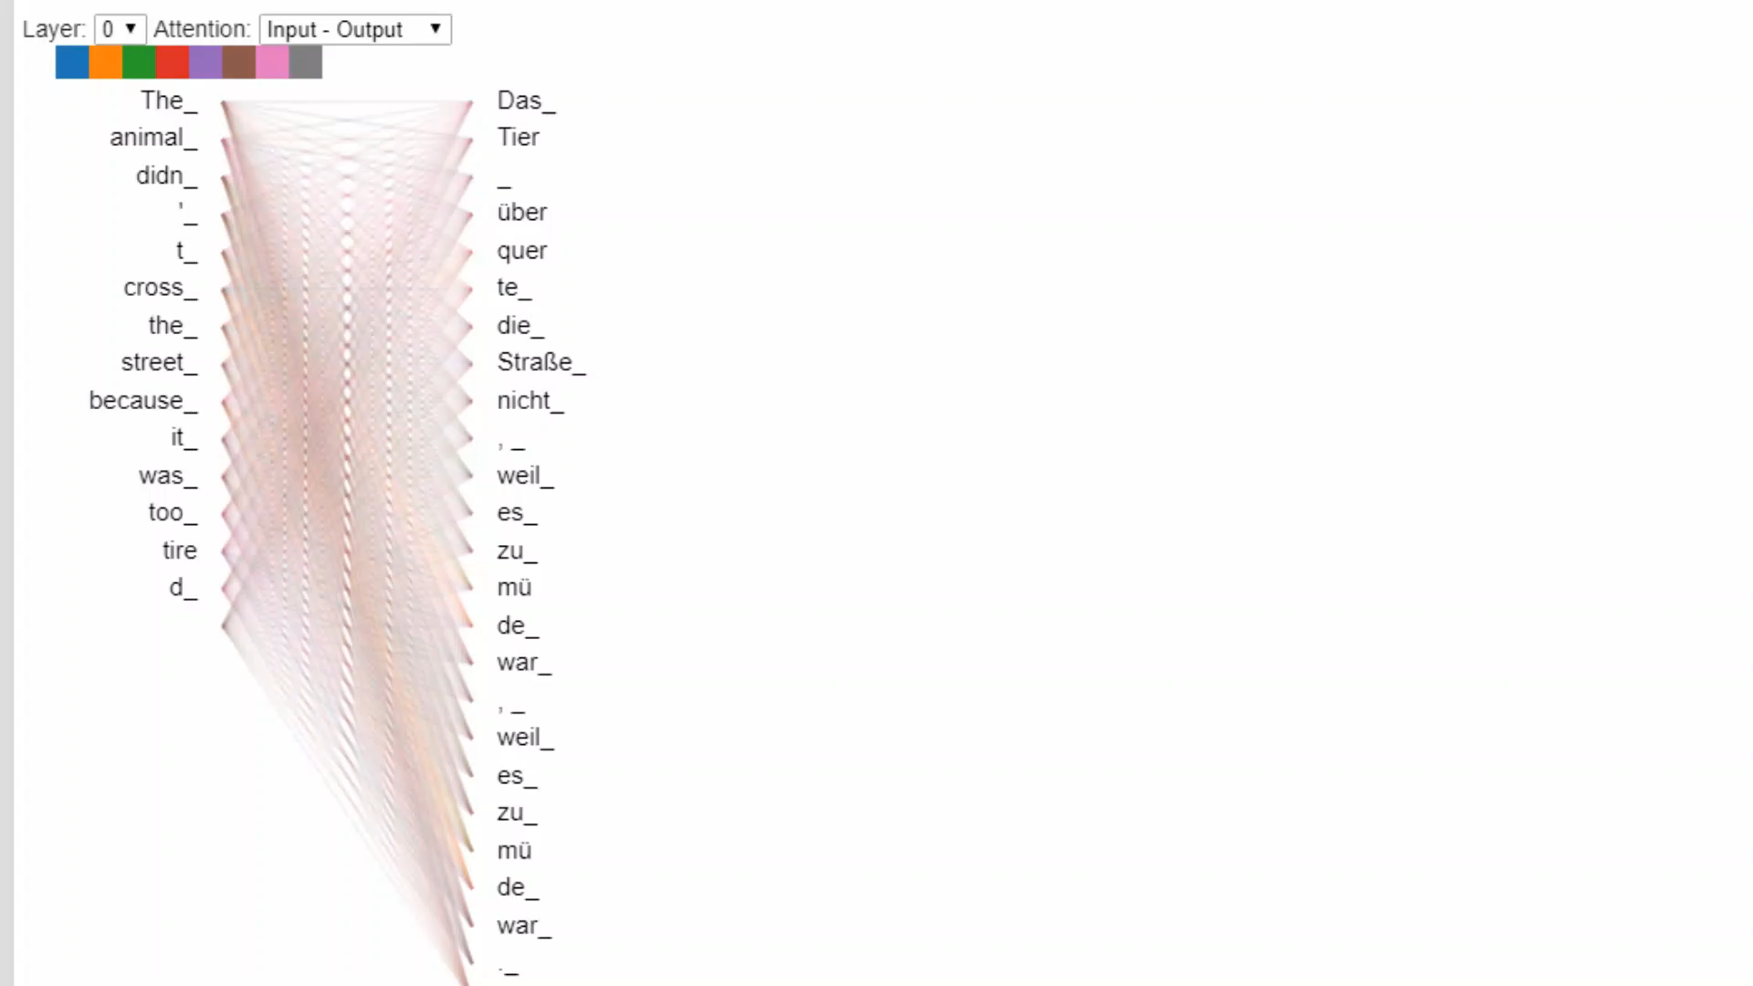

Slide 15
Attention as memory addressing
Input
“External” Memory
Register 1
WRITE
-0.1 0.2 1.8 … 99.1
Register 2
Network
71.0 -34.1 0.01 … -25.5
READ
Register 3
1.95 4.98 -12.22 … 13.0
…..
Output
Learnable attention weights for “soft” read/writes

Slide 16
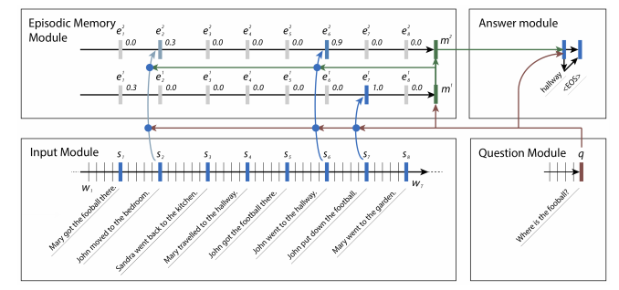
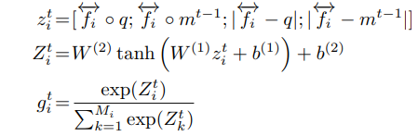
Dynamic Memory Networks
(Slightly simplified), the encoder produces a fixed-length vector for each ‘fact’ in a sequence of sentences.
Compute an attention gate (scalar for each ‘fact’)
Softmax over activation of product of attention weights, question encoding and episodic memory.
Produces “context vector” – weighted combination of facts and question
Ask Me Anything: Dynamic Memory Networks for Natural Language Processing
Ankit Kumar, Peter Ondruska, Mohit Iyyer, James Bradbury, Ishaan Gulrajani, Victor Zhong, Romain Paulus, Richard Socher
https://arxiv.org/pdf/1506.07285.pdf

Slide 17
Many others
Pointer Networks
Differentiable Neural Computer
Hierarchical Attentive Memory
30 minutes not enough to do justice
“Attention Is All You Need” (?)
Next – lightning summary of work by Robert Gens & Pedro Domingos
“Deep Symmetry Networks “
https://www.youtube.com/watch?v=xF5FwDAVSPQ

Slide 18
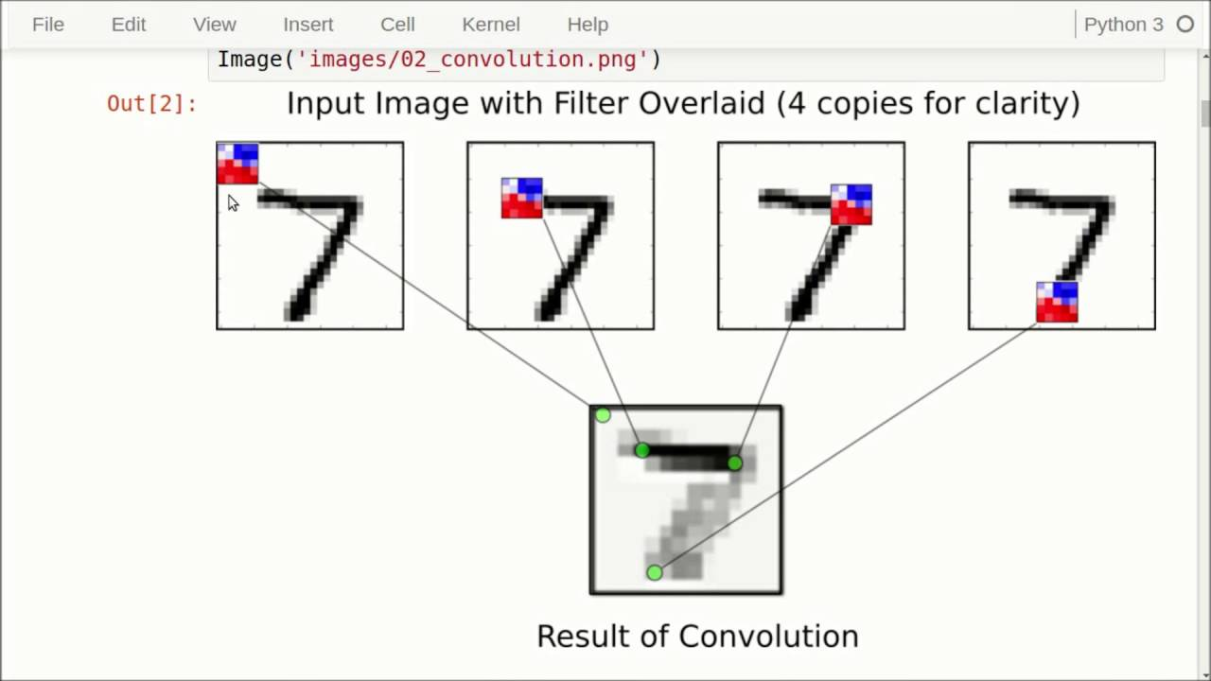
Symmetry-based learning
Returning to convolutional networks
Learn classification task by passing a local 2D filter across width/depth of an image
If we move the image left/right/up/down the filter will still convolve across same local space
Filter will still ‘see’ the exact same window of pixels at the top edge of the
Translation invariant
https://www.youtube.com/watch?v=HMcx-zY8JSg

Slide 19
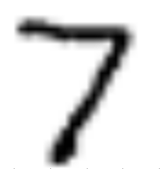
If we rotate the image, the filter window sees an entirely different alignment of pixels
CNN is not rotation-invariant
Network must learn these explicitly by manually augmenting/perturbing training inputs

Slide 20
How can we recognize that a rotated 7 is still a 7?
Do we explicitly learn from 1000s of slightly rotated examples? Possible…
Or did we learn an underlying representation invariant to certain transformations?
If Object + action => same object
Action forms part of the symmetry group
Geometric symmetry - a transformation that maps an object to itself
A square is a square if we reflect about each axis, or we rotate through 90/180/270/360 degrees.
These are the symmetry group of a square
Set of functions that can be composed with closure, associativity, identity and invertibility

Slide 21
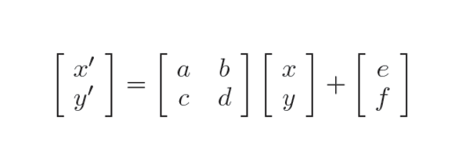
CNN is a “Deep translation network”
filter function + translation symmetry
What about filter function + affine symmetry?
Rotation
Translations
Scaling
Shearing
Reflection

Slide 22
S is a generating set of a group G iff every element of G is expressible as a combination of elements in S and their inverses
“k-neighbourhood” of f in G under S is the subset of elements in G that can be expressed as f composed with elements of S at most k-times

